Slide 1


Content Area Teacher Training (CATT)
Modifying and Developing Materials
Day Four

Slide 2
New!
This PPT is not about your readings.
So much information, so little time!
Think about how this different format helps or harms your comprehension and interest in this week’s activities.
Consider how you may or may not use it in your classes.

Slide 3

Today’s Agenda
Describe the purpose of today’s strategy by explaining different philosophies of learning
Show understanding of information-processing tools (NLRs and Summarizing Strategies) by using them to summarize information.
Apply information-processing strategies in the classroom to increase student achievement.

Slide 4
OVERVIEW
Beliefs
about
Intelligence
Constructivist
Philosophy
of Learning
The importance
of tools to aid
in processing
information

Slide 5
Double Bubble Map:
p. 4
INTELLIGENCE
Intelligence is fixed, deriving from ability.
Intelligence is malleable, deriving from effort.
Emphasis on teacher-provided content
Emphasis on processes to make meaning of content

Slide 6
Philosophies of Learning
p. 5
Behaviorism
Constructivism
Implies a fixed view of intelligence
Intelligence depends on ability
Leads to flat or decreasing achievement (Blackwell, et al.)
Student job: remember bits of information
Emphasis on lower-order cognitive skills
Knowledge is acquired
Easily measurable outcomes
Implies a malleable view of intelligence
Intelligence depends on effort
Leads to increasing achievement (Blackwell, et al.)
Student job: “to consciously construct conceptual understandings that link the ‘bits’ into patterns of information” (Hyerle, 1996, p. 14)
Emphasis on higher-order cognitive skills
Knowledge is constructed
Outcomes are more difficult to measure

Slide 7
constructivism
p. 6
“Much of traditional education breaks wholes into parts, and then focuses separately on each part. But many students are unable to build concepts and skills from parts to wholes. These students often stop trying to see the wholes before all the parts are presented to them and focus on the small, memoriz-able aspects of broad units without ever creating the big picture… We need to see the ‘whole’ before we are able to make sense of the parts.”
Brooks and Brooks, 1993
(as cited in Hyerle, 1996)

Slide 8
constructivism
“Many students who struggle in school do so because they fail to detect or intuit patterns.”
Singer, 2004
“The true discrimination that comes out of poverty is the lack of cognitive strategies. The lack of these unseen attributes handicaps, in every aspect of life, the individual who does not have them.”
Payne, 1998

Slide 9
constructivism
“The central problem that constructivist educators face is not a guiding theory, but concrete strategies and tools for institutionalizing these theoretical and practical understandings into more inclusive classrooms.”
Hyerle, 1996
In other words, students need to learn information-processing strategies to help them “link the ‘bits’ into patterns of information.”

Slide 10
1
2

Slide 11
1
2
Once there were three pigs. The first pig built a house of straw. The second pig built a house of twigs. The third pig built a house of bricks. A big bad wolf came along. He huffed and puffed and blew down the straw house and twig house. The first two pigs ran for safety to their brother’s brick house. The big bad wolf huffed and puffed but could not blow down the brick house.
If I could have any kind of animal for a pet, I would choose a pig. They are very intelligent animals that can be housebroken and that can learn amusing tricks. Pigs also ooze with loyalty; they will scamper around like a puppy when you return after a long day. Their cleanliness is another benefit; contrary to conventional wisdom, pigs keep themselves spotless. For these reasons, a pet pig would be very welcome in my home.
Water is an important natural resource. Water nourishes crops so fruits and vegetables can grow. It also provides much-needed moisture for farm animals. Of course, people also need water to drink and to stay clean. Additionally, water frequently provides energy through hydro-electric plants. Although it often is taken for granted, water is essential.
One could imagine the water cycle starting with clouds made of water droplets. As the droplets grow heavier, they fall to earth as precipitation. This rain and snow collects in rivers and oceans. When the sun heats these bodies of water, evaporation occurs and water vapor rises. High in the cold air the vapor condenses and forms clouds, and the cycle continues.
Harry Truman was born in Missouri and was a farmer, then a captain in the war, and finally the owner of a clothing store before embarking into politics. He gained attention for his ethics as chair of the Senate War Investigations Committee, saving taxpayers billions of dollars in wasteful and corrupt defense spending. Finally he rose to the highest office when FDR died; Truman had been vice president for only a few weeks at the time.
Harry Truman’s decision-making process relied on principles rather than political gain. For example, he advocated for a civil rights platform that conflicted with his own somewhat racist views as well as with the majority of the southern Democrats. Similarly, he resisted the advice of the very popular General MacArthur to expand the Korean conflict; by containing the conflict, Truman likely prevented a third world war.

Slide 12
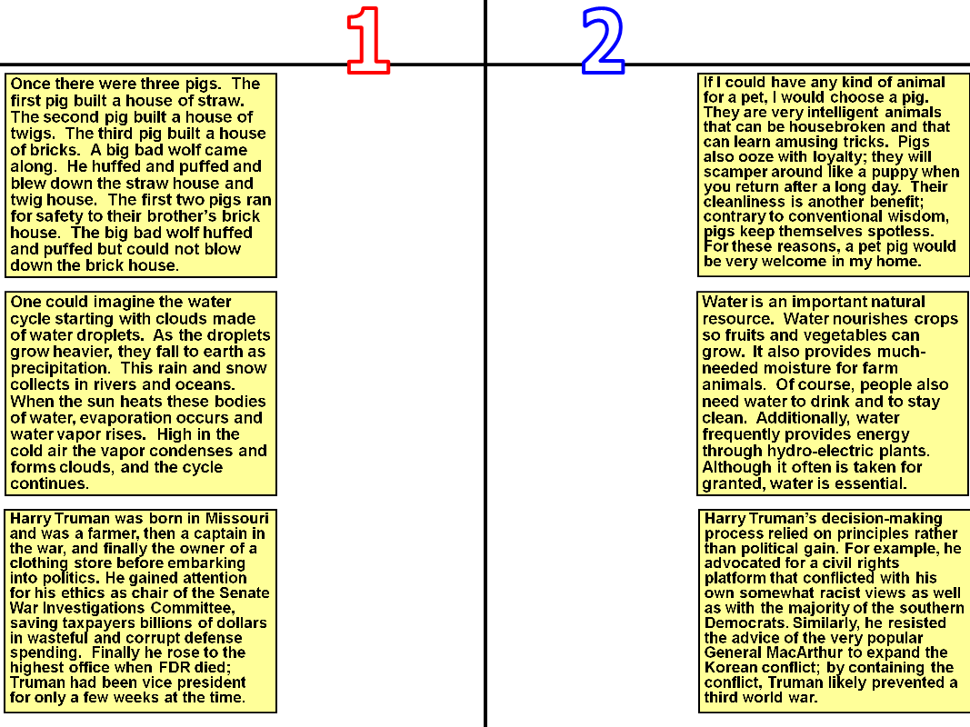
Sequential
Descriptive

Slide 13
General Structures of Information
p. 7
Information
Sequential
Descriptive
Narrative
Non- narrative
Class-ification
Analytical

Slide 14
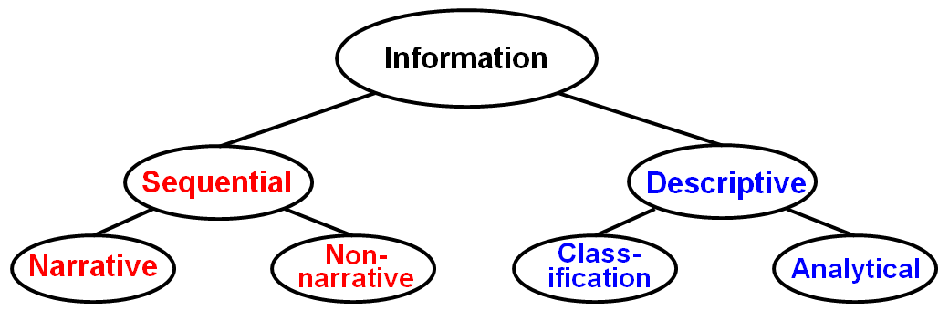
Teacher Decisions
p. 12
Determine broad structure
Determine specific structure
Determine complexity of thinking
Determine how much scaffolding to provide
Teacher provides text and info-processing strategy
Teacher models how to use strategy for given text
Teacher elicits student help using strategy
Students use strategy, with teacher help
Teacher repeats process with other strategies
Students determine which strategy to use
Students read text and apply strategies independently

Slide 15
Closure for the Overview
Construct-ivism
“intelligence = effort” philosophy
Information- Processing tools
increases
Thinking Skills
Student Achievement

Slide 16
NONLINGUISTIC REPRESENTATIONS
Introduction to
Read the information on the following slide (see p. 15)…
At the bottom of p. 15, create a diagram or visual to portray the information in the highlighted section of the passage.
Be ready to describe your thought processes…

Slide 17
“… studies have consistently shown that teachers primarily present new knowledge to students linguistically. They typically talk to students about new content or have them read about the new content (Flanders, 1970). So students are commonly left to their own devices to generate nonlinguistic representations for new knowledge. However, when teachers help students in this endeavor, the effects on achievement are strong. Explicitly engaging students in the creation of nonlinguistic representation actually stimulates and increases activity in the brain (Gerlic & Jausovec, 1999). Although students might not be likely to create non-linguistic representations on their own, you can create opportunities for them to use this strategy.”
Marzano, et. al. (2001). A Handbook for Classroom Instruction that Works.

Slide 18
Nonlinguistic Representations
p. 16
What is nonlinguistic representation?
A means of portraying information through images and/or kinesthetic activities.

Slide 19
Nonlinguistic Representations
2. Why/how does nonlinguistic representation impact student achievement?
The brain stores information in two forms:
Linguistic: actual words and phrases
Imagery: mental pictures and sensations (associations with the five senses)
Teachers relay new information to students primarily through linguistic methods—speech and text.

Slide 20
Nonlinguistic Representations
p. 17
Nonlinguistic representations should be used by students to help them elaborate on (or add to) knowledge.
Benefits include:
More in-depth understanding
Easier recall
20 to 40 percentile- point gains in achievement
Significant gains in intelligence (aptitude)!

Slide 21
Nonlinguistic Representations
The benefits of nonlinguistic representation can be enhanced further by having students incorporate words (spoken or written) to explain/justify their representations.
Return to
your original
sketch/diagram
on page 15…

Slide 22
Nonlinguistic Representations
p. 18
Although there are many types of NLRs, we will focus exclusively on those that correspond to informational structures.
Information
Sequential
Descriptive
Narrative
Non- narrative
Class-ification
Analytical

Slide 23
General Structures of Information
p. 18
Information
Sequential
Descriptive
Time Sequence
Main Idea & Details
Venn Diagram
Narrative
Non- narrative
Class-ification
Process
Claim & Evidence
Analytical
Double Bubble
Episode
Concept & Attributes
Matrix

Slide 24
Non-Narrative
Sequential
Non- narrative
Time Sequence
Process
Episode

Slide 25
Non-Narrative: Time Sequence
Event
Event
Event
Event
Event
Event

Slide 26
Time Sequence: Scientific Method
Research
Ask a question
Hypothesis
Make a plan
Record data
Conclusion

Slide 27
Non-Narrative: Process
Useful for portraying…
Cause/Effect
Problem/Solution
Flow Chart

Slide 28
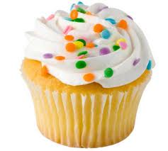
Non-Narrative: Process with a product
Place cups in pan
Preheat oven
Put ingredients in cup pan
Place cupcakes in oven
Mix ingredients
Useful for portraying…
Cause/Effect
Problem/Solution
Flow Chart

Slide 29
Non-Narrative: Episode
Event
Event
Event
Event
DURATION
PLACE
TIME
CAUSE
EPISODE
EFFECT
PERSON
PERSON
PERSON

Slide 30
Non-Narrative: Episode
“Hydrated”
Large # of people
Slow response by law enforcement
10 hour period
Championship game
4th Avenue
March 1997
UA won NCAA
National Championship
Negative publicity
Riots on 4th Ave.
Business owners
Fire/Police
Citizens of Tucson

Slide 31
General Structures of Information
Information
Sequential
Descriptive
Narrative
Non- narrative
Class-ification
Analytical
Time Sequence
Main Idea & Details
Venn Diagram
Process
Claim & Evidence
Double Bubble
Episode
Concept & Attributes
Matrix

Slide 32
Classification
Descriptive
Class-ification
Main Idea & Details
Claim & Evidence
Concept & Attributes

Slide 33
Classification: Main Idea & Details
EXAMPLE
DETAIL
EXAMPLE
MAIN IDEA
DETAIL
DETAIL
EXAMPLE
EXAMPLE
EXAMPLE

Slide 34
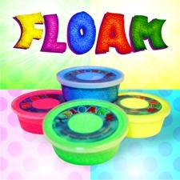
Classification: Main Idea & Details
Both wet or dry
Lasts for Months
Water-soluble
FLOAM is a
wonder product
Easy to Use
Variety of Colors
Polystyrene beads
4 in one order
Blend to create more

Slide 35
Classification: Claim & Evidence
EVIDENCE
EVIDENCE
CLAIM
EVIDENCE
EVIDENCE

Slide 36
Classification: Claim & Evidence
Water boils
Hot to touch
Stoves are Hot
Paper catches
on fire
Warm an
entire house

Slide 37
Classification: Concept & Attributes
EXAMPLE
ATTRIBUTE
EXAMPLE
CONCEPT
ATTRIBUTE
ATTRIBUTE
EXAMPLE
EXAMPLE
EXAMPLE

Slide 38
Classification: Concept & Attributes
Provides interest
Vivid, precise
language
Simple plot
FABLES
Short story
to teach
Animals as
characters
Teaches a
moral or lesson
Simple cast that
act like people
Actions help explain
moral or lesson

Slide 39
General Structures of Information
Information
Sequential
Descriptive
Narrative
Non- narrative
Class-ification
Analytical
Time Sequence
Main Idea & Details
Venn Diagram
Process
Claim & Evidence
Double Bubble
Episode
Concept & Attributes
Matrix

Slide 40
Analytical
Descriptive
Analytical
Venn Diagram
Double Bubble
Matrix

Slide 41
Analytical: Venn Diagram
CONCEPT 1
CONCEPT 2
ATTRIBUTE
ATTRIBUTE
ATTRIBUTE
ATTRIBUTE
ATTRIBUTE
ATTRIBUTE
ATTRIBUTE
ATTRIBUTE
ATTRIBUTE

Slide 42
Analytical: Venn Diagram
Taco Bell
Chipotle
Pre-made
Has drive-through
Extensive menu
Freshly made
No drive-through
Limited menu
Mexican food
Inexpensive
Fast food

Slide 43
Analytical: Double Bubble Diagram
attribute
attribute
attribute
attribute
attribute
CONCEPT
1
CONCEPT
2
attribute
attribute
attribute
attribute
attribute
attribute

Slide 44
Analytical: Double Bubble Diagram
Pre-made
Freshly
made
Mexican
food
Drive
through
No drive
through
Taco Bell
Chipotle
Inex-
pensive
Extensive
menu
Limited
menu
Fast
food
Owned
By
KFC
Owned
By
McD’s

Slide 45
Analytical: Matrix
 | Attribute | Attribute | Attribute | Attribute | Attribute
Concept 1
Concept 2
Concept 3
Concept 4

Slide 46
Analytical: Matrix
 | Form | Level | Develops | Rain | Thunder
Stratus | flat/ layered | low level | stable air | none | none
Stratocumulus | thick | low-mid | warm mixes w/cool | drizzle | none
Cumulus | puffy | mid-level | fair weather | none | none
Cumulonimbus | tall with large base | high-level | air heated by ground | yes | yes

Slide 47
Closure
Predict the information structure(s) that will be most prevalent with the materials you use in your content area.
Defend your prediction… Why do you think this type of structure will be prevalent?

Slide 48
REVIEW
Information
Sequential
Descriptive
Narrative
Non- narrative
Class-ification
Analytical
Time Sequence
Main Idea & Details
Venn Diagram
Process
Claim & Evidence
Double Bubble
Episode
Concept & Attributes
Matrix

Slide 49
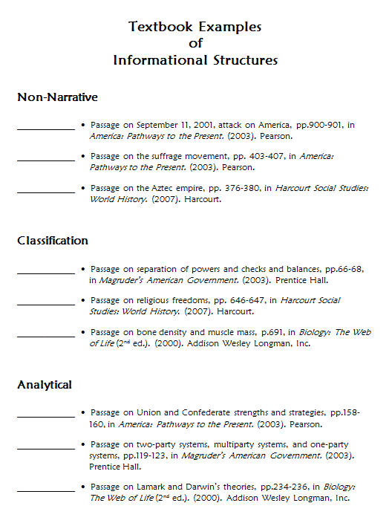
Practice:
Labeling Passages and Creating NLRs
p. 40
Work in groups of 3 or 4.
Choose one excerpt each. Each person should choose from a different category.
For each excerpt…
Read independently
Determine the specific structure
Draw a corresponding NLR

Slide 50
Practice with NLRs
4. Compare your NLRs to “official” versions.
5. Discuss in your small groups.
How did you determine the structure?
Describe your NLR. What were you thinking as you drew it and filled it in?
How did you do? How did completing this assignment require you to construct meaning?

Slide 51
General Structures of Information
Information
Sequential
Descriptive
Narrative
Non- narrative
Class-ification
Analytical
Time Sequence
Main Idea & Details
Venn Diagram
Process
Claim & Evidence
Double Bubble
Episode
Concept & Attributes
Matrix

Slide 52
Information
Sequential
Descriptive
Narrative
Non- narrative
Class-ification
Analytical

Slide 53
Summarizing
After students have processed the information of what they have read using an NLR, they can now use that visual representation to write a summary of the information learned.
If additional scaffolding is needed, you can use Summary Frames to provide necessary linguistic support.

Slide 54
Summary Frames
Time Sequence Frame (pp. 31)
Process Frame (pp. 32)
Episode Frame (pp. 33)
Main Ideas and Details Frame (34)
Claim and Evidence Frame (35)
Concept and Attributes Frame (36)
Analytical Frame (2 concepts) (pp. 37)
Analytical Frame (3 or more concepts) (pp. 38)

Slide 55
Practice with Writing Summaries
Get out the NLR you drew earlier today.
Using the appropriate frame, write a summary.
Use the information from your NLR to write the summary.

Slide 56
Reflection
For today’s reflection, think about all you learned and draw a picture on a scrap piece of paper to represent what you can take away from today’s presentation.
Show your pictures to your small group and describe it.

